Slide 1
Profession Practice in IT Project Endless Runner Game
By James Mullarkey and Liam Higgins
(G00345716@gmit.ie , G00348489@gmit.ie)

Slide 2
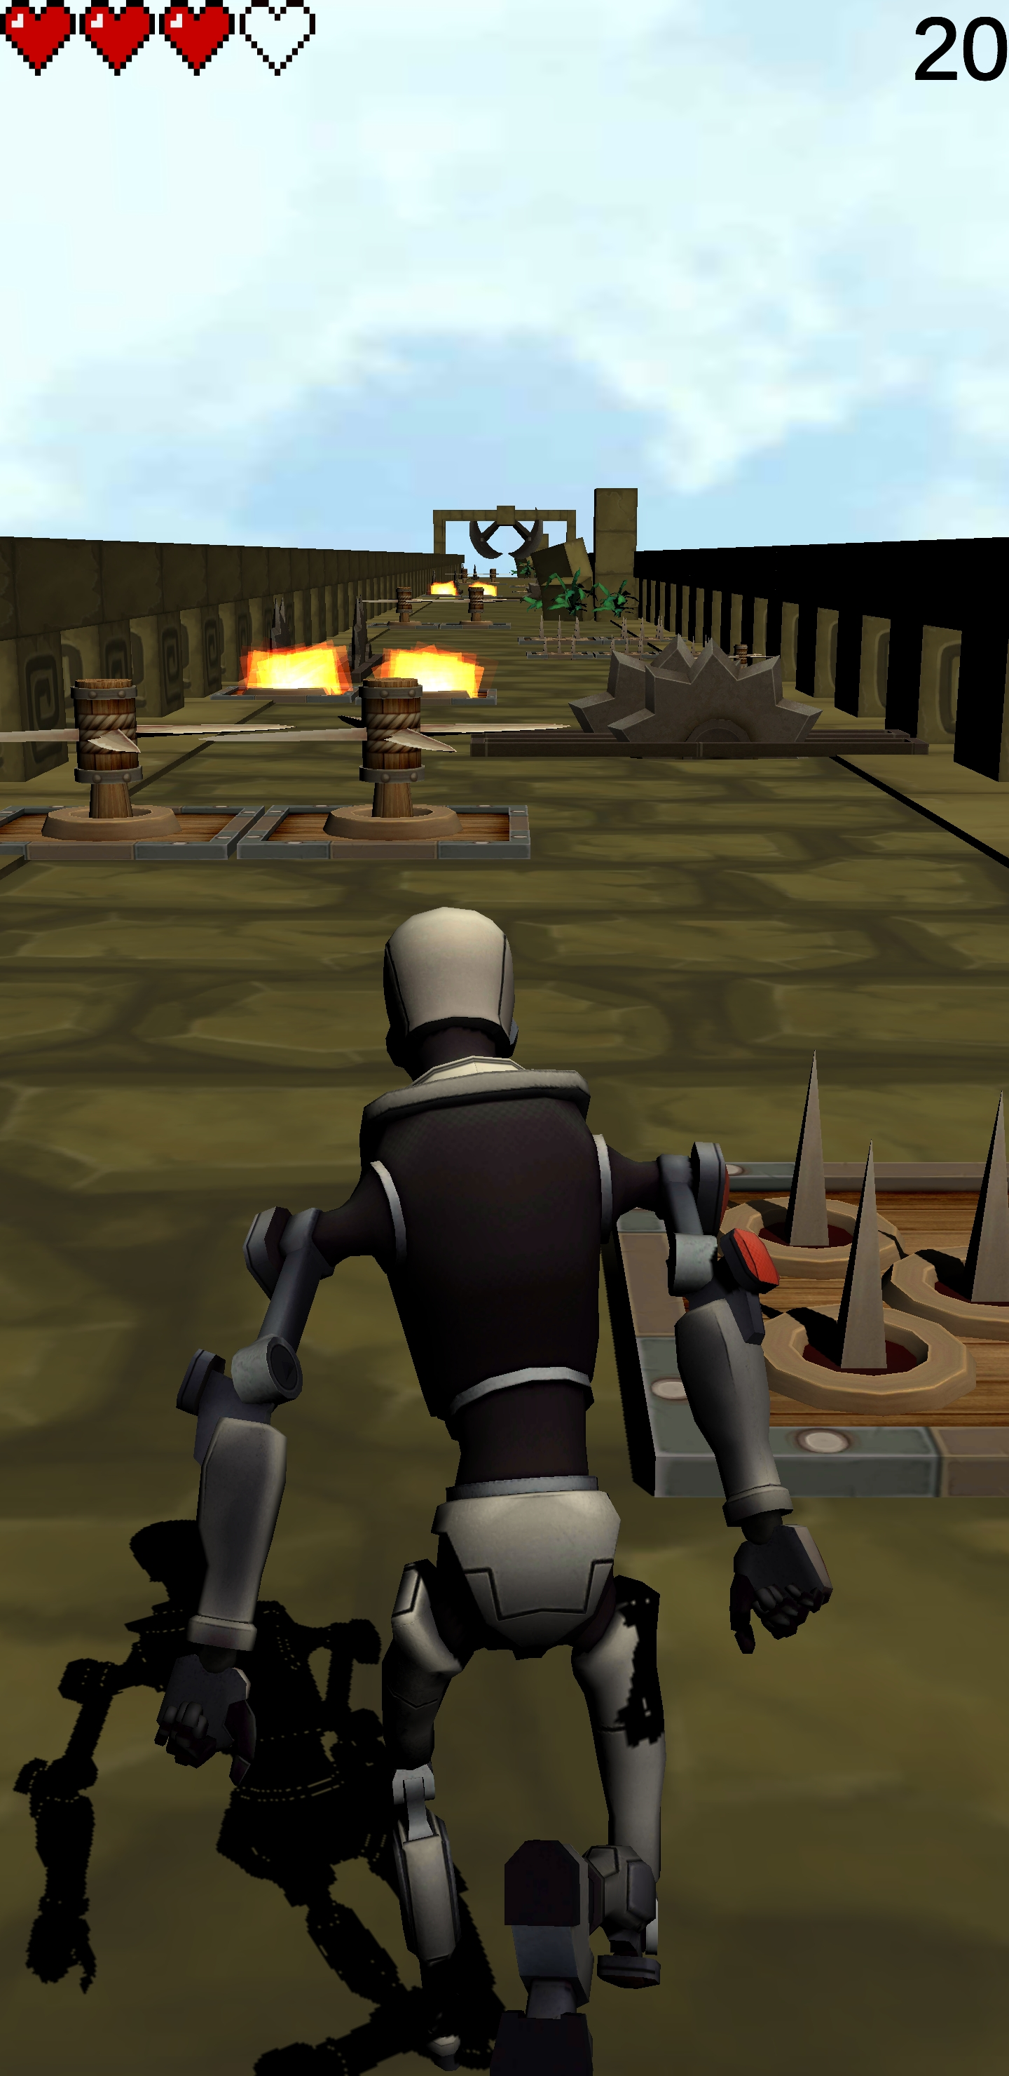
Robot Run (Endless Runner Game)
We made our Endless Runner Game using Unity
We divided the project up into sections and assigned the tasks between us
Our project consists of:
A Character,
Controller for PC and Android
Running animations
Dynamically Generated Environment
Traps
Highscore stored in Reg Editor(Hierarchical Database)
We installed the relevant sdk and jdk for java and got the game running on android

Slide 3
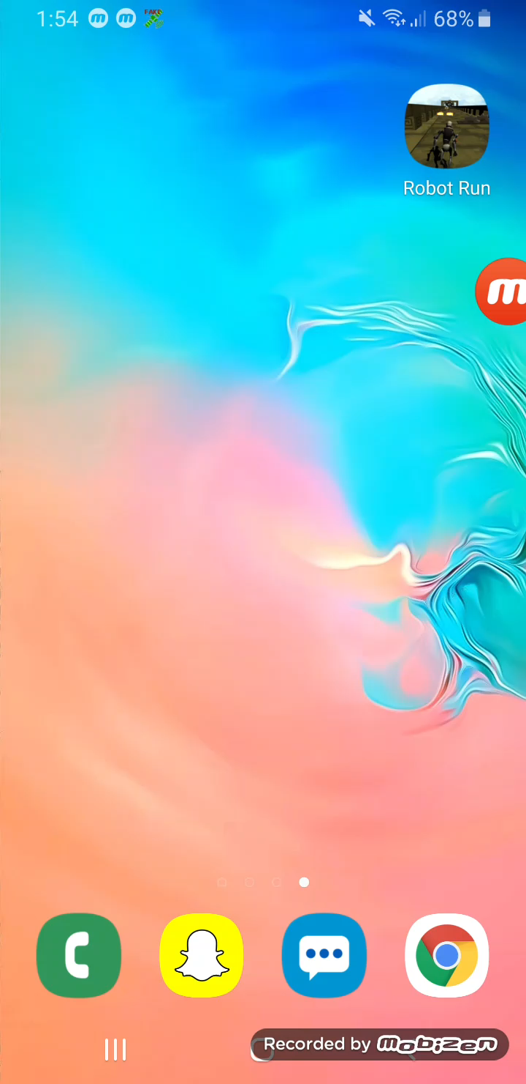
Game Tutorial
Here we show you how the game works
To Play the game you swipe right or left to avoid obstacles
When you lose all four lives you will be shown the Game Over screen, as shown in the video. Your score for the game is displayed here
We used:
GitHub Desktop
PixelArt
Visual Studio Code
Unity 2018

